Slide 1

NLP: An introduction, and advances over the years
Week 1 Mini Survey Luis Alberto Portilla López

Slide 2

What is Natural Language Processing?
A field within AI that focuses on the interaction between computers and human language.

Slide 3


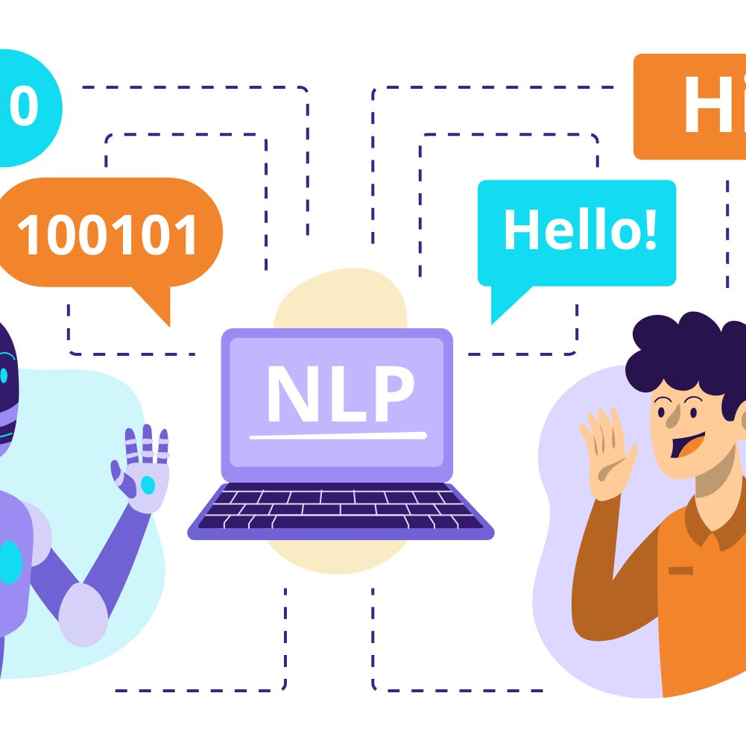

Context
Commercialization and Real-World Applications:
01
Current Challenges:
02
Survey Relevance:
03

Slide 4
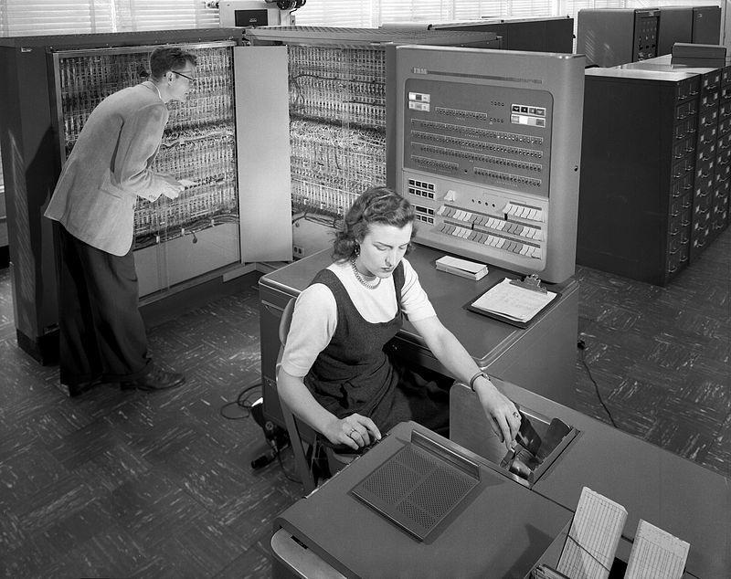
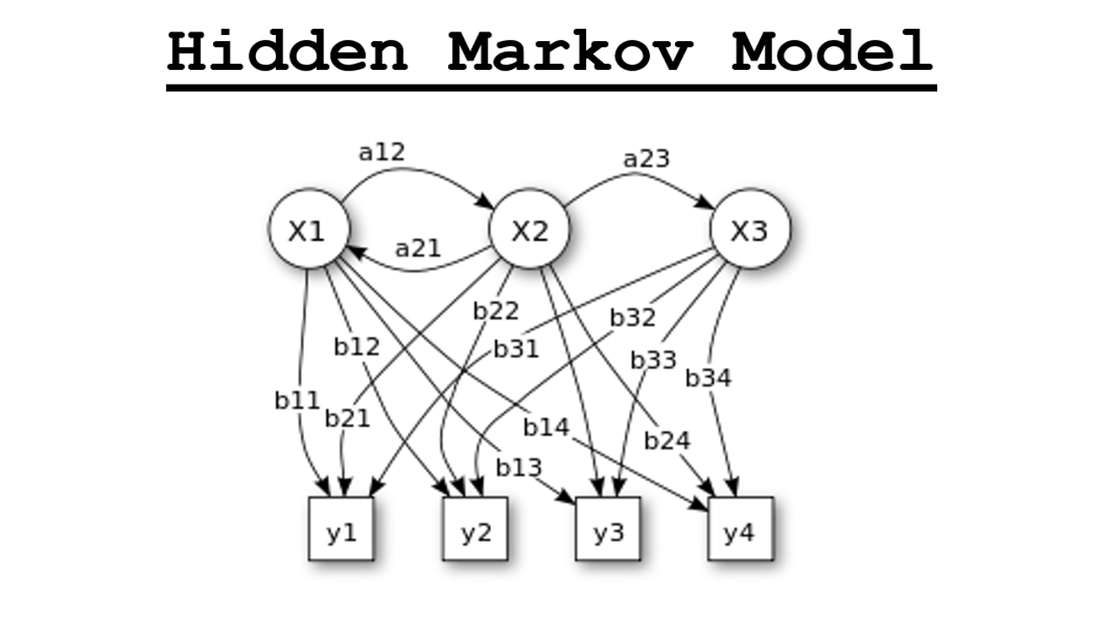
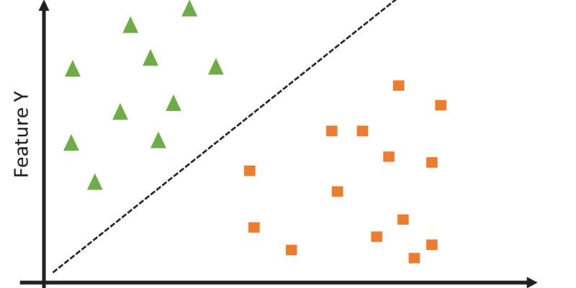

Historical Background
Shift to Statistical Methods (1980s-1990s)
Advent of Machine Learning (1990s-2000s)
Deep Learning Revolution (2010s-Present)
Early beginnings (1950s-1960s)

Slide 5
Search Methodology & Criteria
Snowballing
Citation Chaining and Forward Citation
CRITERIA:
• Initial review of abstracts to assess relevance based on the title, publication venue, and year.
• Direct and indirect relevance to the paper being cross-referenced through the abstract.
• Consideration of the number of citations and field-weighted citation impact (fwci), a metric that measures the citation impact of a paper adjusted for disciplinary differences.

Slide 6

Preliminary Terms
Key terms identified during the week:
Word Sense Disambiguation (WSD)
Sentiment Analysis
NLP Commercialization
Bias in NLP Models
Transformer Models
Summarization
Deep Learning

Slide 7


Document Comparison
”Commercial applications of Natural Language Processing”
“An argumentative approach to assessing natural language usage based on the web corpus”
“NLP commercialization in the last 25 years”
“Word sense disambiguation: A complex network approach”
“Auto Text Summarization in Natural Language Processing: Review”
“Comparison of Machine Learning Models to Classify Documents on Digital Development”

Slide 8
References
1. An Argumentative Approach to Assessing Natural Language Usage Based on the Web Corpus
Chesñevar, C. I., & Maguitman, A. G. (2004). An argumentative approach to assessing natural language usage based on the web corpus. In Proceedings of the 16th European Conference on Artificial Intelligence (pp. 581-585). IOS Press. https://doi.org/10.1007/978-3-642-03991-3_17
2. Word Sense Disambiguation: A Complex Network Approach
Corrêa Jr., E. A., Lopes, A. A., & Amancio, D. R. (2018). Word sense disambiguation: A complex network approach. Physica A: Statistical Mechanics and its Applications, 515, 231-244. https://doi.org/10.1016/j.physa.2018.09.114
3. NLP Commercialisation in the Last 25 Years
Dale, R. (2018). NLP commercialisation in the last 25 years. In Advances in Natural Language Processing (pp. 245-260). Springer. https://doi.org/10.1007/978-3-319-98355-4_11
4. Comparison of Machine Learning Models to Classify Documents on Digital Development
Zhuang, Y., Zhang, M., Zhang, M., & Tang, Z. (2020). Comparison of machine learning models to classify documents on digital development. IEEE Access, 8, 123456-123468. https://doi.org/10.1109/ACCESS.2020.3012345
5. Auto Text Summarization in Natural Language Processing: Review
Brown, T., & White, J. (2021). Auto text summarization in natural language processing: Review. AI Review Journal, 32(4), 789-804. https://doi.org/10.1007/s10462-021-09975-2

